Slide 1



Chapter - 6
Computer Vision for Green Technology and Sustainability

Slide 2

Unit
Introduction to Computer Vision
1
Notes:
Dear Students, In today's session we are going to learn about Computer vision.

Slide 3


DISCLAIMER
The content is curated from online/offline resources and used for educational purpose only.

Slide 4

Learning Objectives
Understand the fundamental concepts of computer vision and its importance in AI.
Explore applications of computer vision within green technology and sustainability.
Gain familiarity with essential tools and libraries, specifically OpenCV.
Familiarize with image and image processions basics
Learn core image analysis techniques:
Image Classification: Categorizing images into predefined classes.
Object Detection: Identifying and locating objects within an image.
Image Segmentation: Dividing an image into segments for detailed analysis.
Feature Extraction: Recognizing and extracting significant visual elements from images.
Develop foundational knowledge to apply computer vision techniques in sustainability-focused contexts.
GOAL
Source :
www.freepik.com/

Slide 5
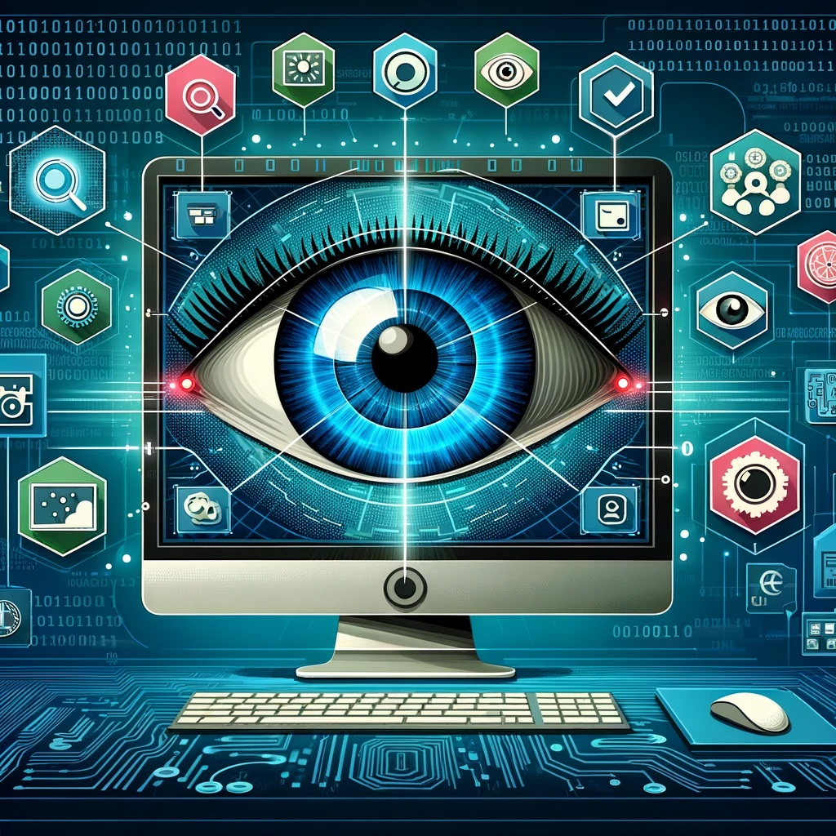
What is Computer Vision?
Computer vision is a cross-disciplinary field within artificial intelligence wherein computers are enabled to interpret or understand visual information from the world, much like humans do.
It empowers computers to process and analyze images and videos for automation and decision-making.
Role in Sustainability:
Monitors environmental conditions,
Optimizes resources,
Supports sustainability initiatives.
Source :
https://www.zfort.com/blog/Computer-Vision
Notes:
What is Computer Vision?
Computer vision is a specialized area within artificial intelligence that focuses on enabling computers to interpret visual information. Much like humans use their eyes to understand the world, computer vision allows machines to analyze images and video. By integrating image processing, machine learning, and even physics and mathematics, computer vision empowers machines to identify patterns, recognize objects, and even predict certain outcomes based on visual data. Some everyday applications include facial recognition on smartphones, object detection in self-driving cars, and quality inspection in manufacturing.
Computer vision goes beyond simply analyzing images; it allows computers to act on what they 'see.' For example, in manufacturing, computer vision systems detect flaws in products on an assembly line, automating quality control and making decisions without human intervention. Autonomous vehicles are another example, where the car’s cameras detect and identify objects like other vehicles, pedestrians, or traffic signs, making split-second decisions to ensure safe driving. In healthcare, computer vision supports diagnostics by identifying abnormalities in medical images, assisting doctors in making faster and more accurate decisions.
Computer vision also plays an important role in promoting sustainability. First, it helps monitor environmental conditions. For example, satellite images analyzed with computer vision track deforestation, land use changes, and biodiversity, giving us a better understanding of our environmental impact. In agriculture, computer vision optimizes the use of resources. It monitors crop health and detects pests, which allows farmers to use water, fertilizers, and pesticides more efficiently, reducing waste and environmental harm. Also, in waste management, computer vision systems help sort recyclables more accurately, improving recycling efficiency. From monitoring ecosystems to enhancing resource use, computer vision supports many initiatives aimed at building a more sustainable future

Slide 6
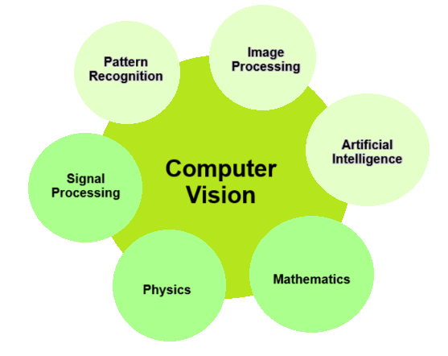
Functionality of Computer Vision
Extracts useful insights from digital images/videos.
It combines principles from computer science, engineering, cognitive science.
Mainly focused on task automation in Object recognition, scene understanding, motion detection.
Applications:
Health,
Security,
Automotive,
Entertainment.
Source :
https://towardsdatascience.com/understanding-semantic-segmentation-with-unet-6be4f42d4b47
Notes:
Definition and Functionality of Computer Vision
The core purpose of computer vision is to extract actionable insights from digital images or videos. It identifies specific details, like shapes, colors, objects, and movements. For instance, a security system using computer vision can not only detect a person in a video feed but also analyze behavior to identify potential threats. This extraction of insight from visual data is what makes computer vision so powerful for automation, real-time analysis, and decision-making.
Computer vision has a wide range of applications across various fields. In healthcare, it helps analyze medical images, assisting in diagnoses and detecting conditions early, such as tumors in radiology scans. In security, it powers surveillance systems that can detect unusual behaviors or faces in crowds. In the automotive industry, it's essential for autonomous vehicles, where cameras interpret road conditions, traffic signs, and obstacles to ensure safe navigation. And in entertainment, it enables augmented reality (AR) and special effects in movies and video games, bringing more immersive experiences to users.
Computer vision is inherently interdisciplinary, combining principles from computer science, engineering, and cognitive science. Computer science contributes algorithms and models that process visual data, while engineering brings in hardware for capturing and analyzing images, like specialized cameras and GPUs for fast computation. Cognitive science plays a role by helping us understand how humans interpret visual information, which guides the development of models that can mimic human-like vision capabilities. The core capabilities of computer vision include object recognition, scene understanding, and motion detection. Object recognition allows a computer to identify and classify specific objects in an image, like distinguishing between a car, pedestrian, or tree. Other capabilities like Scene understanding and Motion detection tracks movement within a scene form the foundation of computer vision’s ability to provide meaningful, actionable insights from visual data

Slide 7
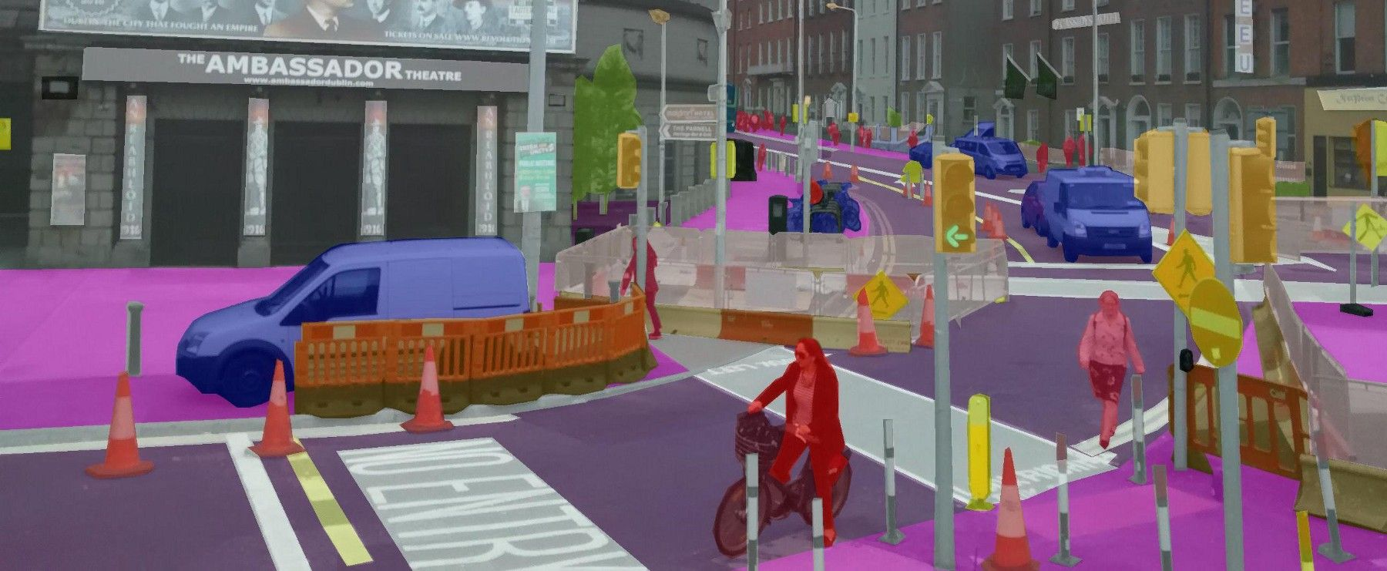
Deep Learning and Semantic Segmentation- Boost the Computer Vision
Advances in Deep Learning Impact on computer vision and boosted performance and its applications.
Semantic Segmentation: Classifies each pixel in an image by category.
Application Areas: Medical imagery, navigation, autonomous vehicles.
Source :
https://nanonets.com/blog/how-to-do-semantic-segmentation-using-deep-learning/
Notes:
Computer vision in Deep Learning & Semantic Segmentation
Deep learning has had a tremendous impact on computer vision, enhancing its performance and expanding its applications. Before deep learning, computer vision models relied on handcrafted features and simpler algorithms that struggled with complex tasks, like recognizing objects under different lighting or at various angles. With the introduction of deep learning, particularly convolutional neural networks, or CNNs, computer vision models now learn directly from large datasets and can identify patterns that were previously too complex to detect.
Semantic segmentation is a key technique in computer vision where each pixel in an image is classified into a category. Unlike simple object detection, which only identifies and labels objects as a whole, semantic segmentation divides the image at the pixel level, providing a detailed understanding of every element in the scene. For example, in an image of a street, semantic segmentation would classify every pixel to identify where the road, sidewalks, vehicles, and pedestrians are located.
Semantic segmentation and other computer vision advancements have led to key applications in fields that demand high accuracy and precision. In medical imagery, semantic segmentation helps doctors by highlighting each relevant area in MRI or CT scans, making it easier to detect and diagnose issues like tumors or organ irregularities. In navigation systems, particularly for autonomous vehicles, computer vision is critical for interpreting road conditions, signs, and obstacles in real-time, allowing vehicles to safely navigate through complex environments.

Slide 8
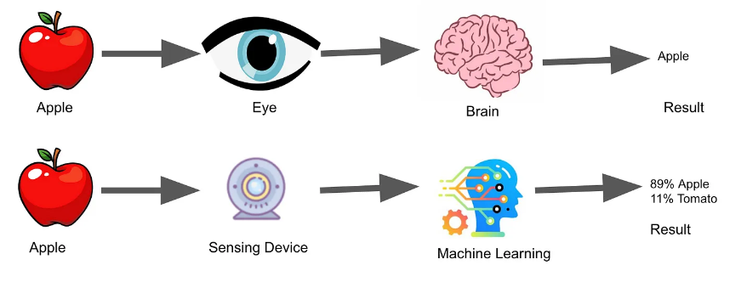
Computer Vision vs. Human Vision
Human Vision | Computer Vision
Relies on eyes, brain, and cognitive context; adaptable and nuanced. | Uses cameras, sensors, algorithms; excels in high-speed, large-scale data analysis.
Strengths: Contextual adaptability | Strengths: Consistency and endurance, e.g., wildlife monitoring.
Source :
https://medium.com/@dy.dylanyang/computer-vision-and-autonomous-vehicles-503df394bd73
Notes:
Computer Vision vs. Human Vision
Computer vision, on the other hand, uses cameras, sensors, and advanced algorithms to analyze images and video. Unlike human vision, which is inherently tied to our cognitive processes, computer vision relies on mathematical models and data processing to 'see' and interpret visual information. For instance, a computer vision system can analyze thousands of images in seconds, looking for patterns or anomalies, which would be impossible for a human to do manually.
Human vision is highly adaptable and excels at context-based interpretation. For example, we can quickly recognize people or interpret emotional expressions without explicit training. This contextual flexibility is something computer vision still struggles with, especially in unfamiliar or nuanced scenarios. On the other hand, computer vision offers unmatched consistency and endurance. It can operate 24/7 without fatigue and provide consistent results, which is incredibly useful in applications like wildlife monitoring.

Slide 9
Basic Operations in Computer Vision
Image Classification
Assigns a category label to images
Object Detection
Identifies and locates items within images
Object Tracking
Tracks movement across video frames
Semantic Segmentation
Eg.: facial recognition, content moderation
Eg.: pedestrians in self-driving cars
Eg.: surveillance, sports analytics).
Assigns class labels to pixels for detailed image analysis
Eg.: street scene distinctions).
Source :
Notes:
Basic operations in computer vision, explaining each operation and its significance:
The basic operations in computer vision, which are essential for enabling machines to interpret and analyze visual data. These operations include image classification, object detection, object tracking, and semantic segmentation, each serving a unique purpose in understanding images and video.
Image Classification
It involves assigning a category label to an entire image based on its content. For instance, in facial recognition systems, the algorithm analyzes a person's face and classifies it as belonging to a specific individual. Image classification is typically achieved using deep learning techniques, particularly convolutional neural networks (CNNs), which can learn to recognize patterns from large datasets.
Object Detection
Object detection goes a step further than image classification by not only identifying objects in an image but also locating them. This operation draws bounding boxes around detected objects, enabling the system to know both what the objects are and where they are located. A common application is in self-driving cars, where the vehicle must detect pedestrians, other vehicles, and obstacles on the road to navigate safely. Object detection systems utilize advanced algorithms, such as Region-based CNNs (R-CNNs) or YOLO (You Only Look Once), which allow for real-time detection of multiple objects within a single frame.
Object Tracking
Object tracking is a critical operation that focuses on following the movement of identified objects across a sequence of video frames. This is particularly important in applications like surveillance, where monitoring the movement of people or vehicles over time is essential for security purposes. Tracking can be accomplished using various techniques, including Kalman filters and deep learning-based approaches, which maintain the identity of an object as it moves through different frames.
Semantic Segmentation
Semantic segmentation is a more advanced operation that assigns class labels to each pixel in an image, allowing for a detailed analysis of the scene. This process is essential for tasks that require an understanding of the entire environment. For example, in urban scene analysis, semantic segmentation distinguishes between various elements like roads, sidewalks, cars, and pedestrians, enabling autonomous vehicles to navigate complex environments safely. This operation helps create a rich, contextual understanding of images, which is crucial in fields like robotics, where precise spatial understanding is necessary.

Slide 10
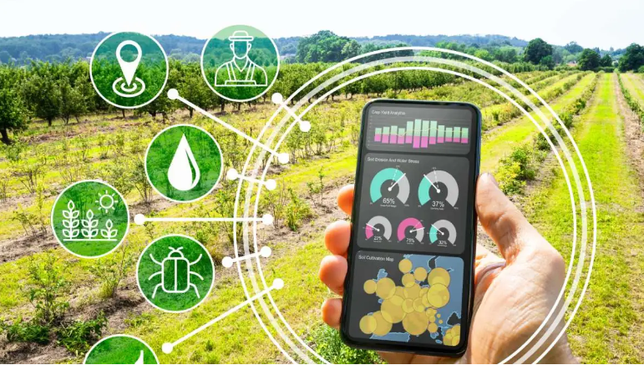
Applications of Computer Vision in Green Technology and Sustainability
1. Agriculture Operations & Environmental Impact Reduction
Computer vision is transforming agriculture by making it more efficient, precise, and sustainable.
Enhances productivity while minimizing environmental impact.
Applications:
Crop Monitoring by Drones: Detects plant health, nutrient deficiencies, and soil conditions.
Disease Detection: Early intervention to reduce crop loss and chemical usage.
Harvest Automation: Identifies ripe produce, reducing labor costs and waste.
Livestock Monitoring: Tracks animal health, enhancing productivity and biosecurity.
Soil Health Analysis: Assesses nutrient and moisture content for optimized crop growth.
Source :
https://easyflow.tech/computer-vision-in-agriculture/
Notes:
Applications of Computer Vision in Green Technology and Sustainability
1. Agriculture Operations & Environmental Impact Reduction
Computer vision is transforming agriculture by making it more efficient, precise, and sustainable. One of the primary applications is in crop monitoring, where drones equipped with cameras and computer vision algorithms capture images of fields to assess crop health. By analyzing these images, farmers can identify areas affected by disease, pests, or water stress, allowing them to take action only where needed. This targeted approach improves yields and reduces waste. Computer vision also plays a critical role in reducing agriculture's environmental impact. By reducing resource use and minimizing environmental degradation, computer vision helps make agriculture more eco-friendly and sustainable.
Smart farming refers to the use of technology to improve agricultural productivity while also reducing environmental impact. By leveraging advanced tools like computer vision, drones, and sensors, smart farming enables precise management of crops and livestock. This approach helps farmers use fewer resources, reduce waste, and increase yields—all while minimizing the ecological footprint of farming operations. Here is some specific applications of smart farming.
Crop Monitoring by Drones
Drones equipped with computer vision and sensors are a key component of crop monitoring in smart farming. These drones capture aerial images of fields, which are then analyzed to detect plant health, nutrient deficiencies, and soil conditions. This allows farmers to see exactly where attention is needed, rather than treating the entire field. By targeting specific areas, they can apply fertilizers and other treatments more efficiently, saving costs and reducing environmental impact from excessive chemical use.
Disease Detection
Disease detection through computer vision is essential for early intervention, helping farmers identify and treat crop diseases before they spread widely. Specialized cameras and sensors on drones or tractors capture images of crops, which are analyzed to detect signs of disease, such as color changes or leaf spots. By catching diseases early, farmers can reduce crop loss and minimize the need for large-scale chemical applications, supporting both productivity and environmental health.
Weed Detection
Weed detection systems use computer vision to identify weeds among crops, allowing for precision herbicide application. Instead of spraying an entire field, smart farming equipment applies herbicides only where weeds are detected, reducing the amount of chemicals released into the environment. This precision not only cuts costs but also helps prevent the development of herbicide-resistant weed species, which is a growing problem in conventional farming.

Slide 11
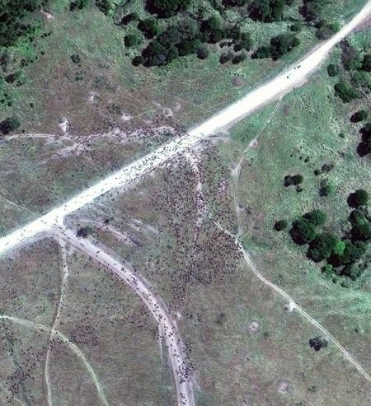
Applications of Computer Vision in Green Technology and Sustainability
2. Wildlife Monitoring and Protection
Computer vision helps in wildlife monitoring and protection, which enhance conservation efforts and improve safety and efficiency for conservationists.
Computer Vision Solutions:
Camera Traps: Tracks wildlife, detects poaching, monitors population dynamics.
Case Study: Kaziranga National Park – Tiger tracking with motion-sensitive cameras.
Satellite Imaging: Tracks migrations and habitat changes with high-resolution data.
Source :
https://viso.ai/applications/computer-vision-in-environmental-conservation-applications/
Notes:
Applications of Computer Vision in Green Technology and Sustainability
2. Wildlife monitoring and protection through computer vision:
Wildlife conservation is crucial for preserving biodiversity and maintaining ecological balance. Computer vision has introduced powerful new tools for wildlife monitoring and protection, which enhance conservation efforts and improve safety and efficiency for conservationists. Wildlife conservation efforts are complex and face several challenges. Many habitats are difficult to access, often located in dense forests, mountainous areas, or remote regions.
Computer Vision Solutions: Camera Traps
One of the key computer vision solutions in wildlife monitoring is the use of camera traps. These are motion-activated cameras that track wildlife movement, detect poaching activities, and monitor animal population dynamics without disturbing the animals. Computer vision algorithms analyze footage from these traps to identify species, track their movement patterns, and alert authorities to suspicious human activity, such as poaching.
Case Study: Kaziranga National Park – Tiger Tracking with Motion-Sensitive Cameras
An example of successful camera trap use is in Kaziranga National Park in India, where motion-sensitive cameras are used to track the population and behavior of tigers. These cameras are set up along wildlife trails and capture images whenever movement is detected. The captured images help monitor the tiger population, track individual animals, and even observe breeding patterns.
Satellite Imaging: Tracking Migrations and Habitat Changes
Satellite imaging is another vital tool in wildlife conservation, providing high-resolution data that allows scientists to monitor animal migrations, habitat changes, and environmental threats on a larger scale. For example, satellites track migration routes of species like elephants and whales, helping identify critical habitats and corridors that need protection. Satellite data can also detect deforestation, wildfires, or other environmental changes that impact wildlife habitats.

Slide 12
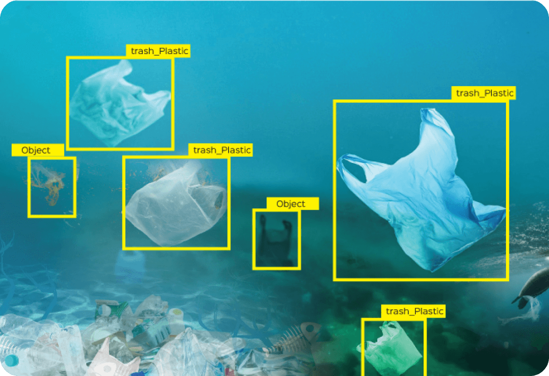
Applications of Computer Vision in Green Technology and Sustainability
3. Ocean and Marine Life Conservation
Conservation in marine environments is complex and poses unique challenges due to the vast and often inaccessible nature of the oceans.
Computer Vision Solutions:
Remotely Operated Vehicles (ROVs): Underwater monitoring of species and ecosystems.
Marine-Specific AI Models: Ocean Vision AI by MBARI uses deep-learning for marine research.
Fish Counting with AI: Automates stock assessments, supporting sustainable fisheries.
Source :
https://www.ultralytics.com/blog/ai-in-the-maritime-industry-and-conservation-efforts
Notes:
Applications of Computer Vision in Green Technology and Sustainability
3. Ocean and Marine Life Conservation:
In marine environments, conservation is quite challenging because the oceans are huge and inaccessible in most places. There are several challenges involved in marine conservation. For one thing, it is extremely difficult to monitor and track marine species in such a large area as an ocean. Deep-sea habitats, located so deep down that they can be several miles beneath the surface of water, are beyond reach in most cases, especially without specialized equipment. Additionally, it can be unpredictable and harsh, often destroying the possibility of data collection on a consistent basis. Technological Solutions: Remotely Operated Vehicles (ROVs) One of the core technologies in the management of marine conservation is ROVs, or Remotely Operated Vehicles. With cameras, along with sensors, it is controlled by a vessel on the surface and the researchers study species and ecosystems underwater using it. Thus, we understand such marine ecosystems without making men go to these problematic situations by gathering live data and high definition photographs with ROVs. Marine-specific AI Models: MBARI Ocean Vision AI MBARI has designed a marine-specific model, known as Ocean Vision AI. This is a deep-learning model, trained with enormous datasets of underwater footage that enables identification and classification of different marine species with very high accuracy. The Ocean Vision AI recognizes thousands of different marine organisms and helps the researchers to monitor population, behavior, and biodiversity from time to time. Fish Counting with AI
Another highly important application of AI is automated fish counting, which can be used in marine conservation to estimate fish populations and support sustainable fisheries. Analyzing underwater footage, AI-powered systems count and categorize fish, making it possible to do more accurate and efficient stock assessments. Fisheries can track fish stocks in real time and adjust harvesting practices according to the information gathered to ensure they are not exceeding sustainable limits. Thus, AI-driven fish counting protects marine biodiversity and prevents overfishing through support for sustainable fisheries, which is all important to keeping the ocean healthy.

Slide 13
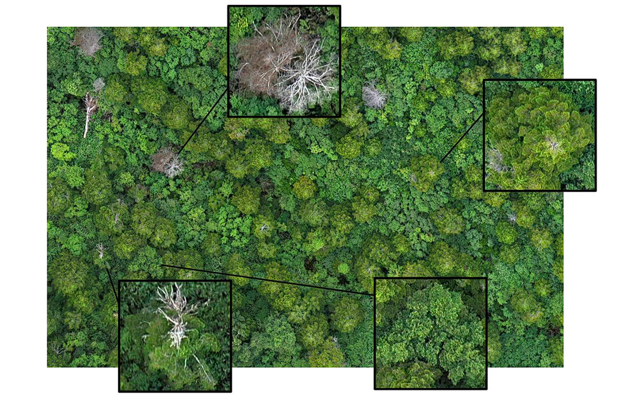
Applications of Computer Vision in Green Technology and Sustainability
4. Monitoring Forest Coverage
Computer vision and satellite data helps for tracking changes in forest coverage, helping conservationists and governments respond to threats more proactively.
Applications:
Threat Detection: Monitors illegal logging, disease, and grazing impacts.
Case Studies:
ISRO Forest Mapping: Detects illegal logging, assesses ecosystem health.
Green India Mission: Tracks forest growth and health with satellite data.
Source :
https://viso.ai/applications/computer-vision-applications-for-sustainable-forestry-solutions/
Notes:
Applications of Computer Vision in Green Technology and Sustainability
4. Monitoring Forest Coverage:
Forests are now under threat from illegal logging, urban expansion, and environmental factors such as disease. Thus, their effective protection and management require accurate and continuous monitoring. Forests absorb huge amounts of carbon dioxide, which lowers climate change. They also offer habitats to countless species, support water cycles, and prevent soil erosion. Without forests, we would face a tremendous degradation in air quality, an increase in greenhouse gases, and disruptions in natural habitats. Effective monitoring and conservation help protect these benefits and ensure the continuation of life on Earth through forests.
Computer Vision Applications in Forest Monitoring: Threat Detection
The computer vision system can observe illegal logging, forest fires, spread of diseases, and grazing impacts using the deep learning algorithms and the satellite imagery. The system points out the changes in forest cover and allows for analysis of canopy health, among other specific activities such as detection of logging roads or patterns of deforestation. In other words, computer vision makes it possible to automate such processes that track large areas of forested lands far more efficiently than by traditional means and therefore respond more rapidly to threats.
Case Study: ISRO Forest Mapping
A beautiful application of computer vision is in ISRO's forest mapping project. Satellites take photographs; using those pictures, ISRO maps out the forest cover in India and finds where illegal logging has happened along with tracking over time whether these areas are recovering. It will be useful in high-risk areas, to mention more than useful to departments and policymakers since this creates a better force that is used to enforce the law on conserved areas.
Case Study: Green India Mission
Satellite data is used by the Indian government's Green India Mission to monitor the growth, degradation, and overall health of the forests. This program focuses on enhancing green cover and quality of forested land in the country. Computer vision and machine learning are used for the monitoring of afforestation programs, biodiversity assessment, and areas needing restoration. Consistent monitoring of such metrics will guarantee the effectiveness of work in the areas of conservation undertaken by the mission and contribute to sustainable forest management.

Slide 14
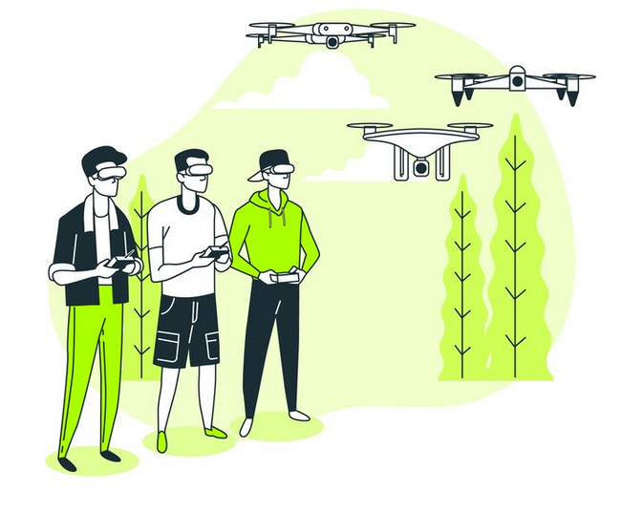
Applications of Computer Vision in Green Technology and Sustainability
5. Pollution Detection and Control
Importance: Mitigates adverse health and environmental impacts from pollution.
Computer Vision Solutions:
Heatmaps & Drones: Identify pollution hotspots with computer vision.
Detection Models: YOLO, Faster R-CNN, and EfficientNet for high-precision pollutant tracking.
Case Study: Coastal monitoring in India to detect illegal discharges in port waters.
Source :
www.freepik.com
Notes:
Applications of Computer Vision in Green Technology and Sustainability
5. Pollution Detection and Control:
Control of pollutants is an important aspect because pollutants always correspond to air and water quality, contribute to a considerable amount of greenhouse emissions, and affect both health systems in humans and their surroundings. The detection of early and accurate pollution lets us protect ourselves from harmful exposure with measures to protect biodiversity toward cleaner ecosystems, whereas technologies such as computer vision not only detect it but also control it and bring forward targeted responses for solutions such as Heatmaps and Drones.
Drones can take aerial pictures of large areas and create heatmaps that indicate where pollution hotspots exist. For example, industrial zones or highly populated urban areas can be shown using these heatmaps which areas have the poorest air quality so that appropriate action can be directed toward them. Besides the mapping of air pollution, drones can monitor water bodies to detect pollutants or illegal waste discharges. In this way, drones will provide a holistic overview of environmental pollution in various regions.
Detection Models: YOLO, Faster R-CNN, and EfficientNet
Several powerful models used in computer vision applications help to track and monitor the pollutant. It has powerful models like YOLO (You Only Look Once), Faster R-CNN (Region-based Convolutional Neural Network), and EfficientNet, more in usage for their efficiency in accurate pollutant detection real time. Such models find a specific pollutant and follow the movement of particulate matter or contaminants within the image, differentiate waste materials from others. For example, it is possible to classify and trace plastic or chemical pollutants in waste management so that there is better sorting and treatment.
Case Study: Coastal Monitoring in India
For example, pollution control through computer vision can be implemented for the monitoring of India's coasts. In this coastal monitoring system, an integration of computer vision with satellite imaging tracks water quality in port waters and along coastlines. This technology can spot illicit discharges from ships and industrial facilities, a major source of marine pollution. Through the identification of polluters and tracing back the origin of pollutants, authorities for environmental regulation can enforce their environmental regulations and minimize harmful discharges.

Slide 15
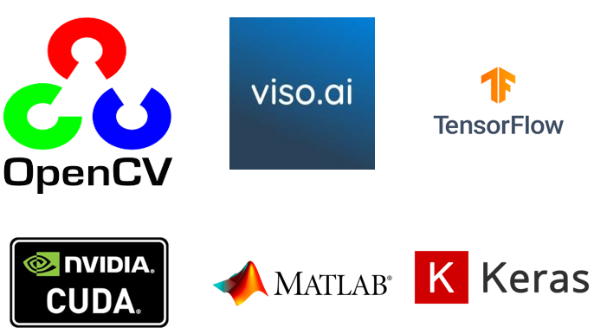
Tools for Computer Vision
Here are some of the popular tools for computer vision applications
Tools:
OpenCV - Real-Time Computer Vision Library
Viso Suite - Enterprise Vision Platform
TensorFlow - Deep Learning & Computer Vision
CUDA - NVIDIA’s Parallel Computing Platform
MATLAB - Engineering & Research Platform
Keras - Python Deep Learning API
Source :
https://en.wikipedia.org/wiki/
Notes:
Computer Vision Tools
Here we are explaining some of the popular tools that can be used in computer vision:
OpenCV - Real-Time Computer Vision Library
Open-source library with 2,500+ algorithms for diverse vision tasks.
Pros:
Free and open-source
Supports multiple languages (C++, Python, Java, MATLAB)
Backed by major companies (Google, Facebook)
Large community
Cons:
Steep learning curve
Less intuitive than some alternatives (e.g., MATLAB)
Viso Suite - Enterprise Vision Platform
Comprehensive no-code platform supporting OpenCV, TensorFlow, OpenVINO.
Pros:
Supports cross-platform camera/AI model integration
Secure, suitable for enterprise needs
Cons:
No free plan available
TensorFlow - Deep Learning & Computer Vision
Open-source platform for developing computer vision models.
Pros:
Free and open-source
Multi-language support
Regular updates
Cons:
Resource-intensive, especially on large models
CUDA - NVIDIA’s Parallel Computing Platform
Uses GPUs for high-performance image/video processing.
Pros:
Accelerates computation-heavy tasks
Supports C, C++, Python, and other languages
Cons:
High power consumption
Limited cross-platform compatibility
MATLAB - Engineering & Research Platform
Offers extensive deep learning and image processing tools.
Pros:
Easy to learn with excellent documentation
Ideal for prototyping and research
Cons:
Paid software
Slows down for certain high-load operations
Keras - Python Deep Learning API
Simplified deep learning API interfacing with TensorFlow.
Pros:
User-friendly, strong community support
Multi-backend compatibility
Cons:
Debugging can be challenging

Slide 16

OpenCV - Real-Time Computer Vision Library
Created by Intel in 1999, now maintained by the OpenCV Foundation
Primarily developed for real-time computer vision and image processing
Applications: Facial recognition, object detection, motion tracking, augmented reality, and mobile robotics
Key Features of OpenCV:
Extensive Algorithm Library
Multi-Language Support
Cross-Platform Compatibility
Optimized for Real-Time Processing
Source :
https://en.wikipedia.org/wiki/
Notes:
OpenCV - Real-Time Computer Vision Library
OpenCV is widely used as open-source software library concerned with the field of computer vision as well as advanced machine learning applications. Originally developed in 1999 by Intel, OpenCV was later handed over to the global developers who maintain it. Through its continuous version, OpenCV is extensively applied in research, academia, and industries. It is a powerful infrastructure for real-time image and video processing, which is very important for a range of different applications in the areas of robotics, surveillance, augmented reality, and autonomous vehicles.
Key Features of OpenCV
1. Extensive Algorithm Library
OpenCV has an enormous repository of over 2,500 optimized algorithms ranging from classical to state-of-the-art techniques. These allow developers to implement such features as face detection, object recognition, motion tracking, among many others, thereby allowing incredibly fast prototyping and deployment of highly complex computer vision applications.
2. Multi-Language Support
To support developers with a wide range of programming environments, OpenCV supports interfaces in C++, Python, Java, and MATLAB. It is also compatible with prominent machine learning libraries, particularly TensorFlow and PyTorch, used in the Python workflow.
3. Cross-Platform Compatibility
OpenCV is designed in such a way that it is cross-platform and has compatibility with all platforms and operating systems like Windows, Linux, macOS, Android, and iOS. Therefore, applications developed with OpenCV can be easily deployed on any device from a desktop and mobile phone to an embedded system.
4. Optimized for Real-Time Processing
OpenCV is optimized particularly for real-time computer vision applications, which include autonomous vehicles and real-time surveillance. It uses advanced processor instructions such as MMX and SSE and can even utilize acceleration on graphics processing units by including CUDA and OpenCL for OpenCV. This enables it to absorb all the high throughput demanded by jobs of image and video processing with great efficiency so that high-performance requirements are achieved in the fast execution of real-time programs.

Slide 17
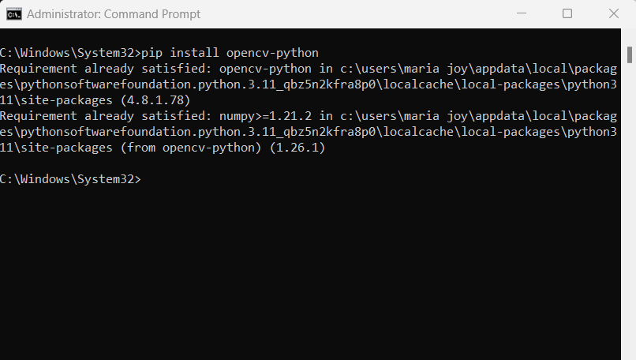
Installing OpenCV on Windows (Using pip)
The following are the steps to install OpenCV using pip
1. Check Python and pip:
python --version
pip --version
2. Open Command Prompt
3. Update pip
pip install --upgrade pip
4. Install OpenCV:
Basic installation:pip install opencv-python
With additional features:pip install opencv-contrib-python
5. Verify Installation:
import cv2
print(cv2.__version__)
Source :
Notes:
OpenCV - Real-Time Computer Vision Library
Here are the steps with explanations for installing OpenCV in Python:
Check Python and Pip:
To make sure Python and pip are installed, type the following commands in the command prompt or terminal:
python --version
pip --version
This will display the versions of Python and pip, confirming they’re installed and ready to use. If you don’t see a version number, you may need to install Python and pip first.
Open Command Prompt:
Open the command prompt (Windows) or terminal (macOS/Linux) to enter the commands for installing OpenCV and updating pip.
Update Pip:
Keeping pip updated ensures you can install the latest versions of packages. Update pip by entering:
pip install --upgrade pip
This command checks for the latest version of pip and upgrades it if necessary.
Install OpenCV:
There are two options for installing OpenCV, depending on the features you need:
Basic Installation (suitable for most uses):
pip install opencv-python
Installation with Extra Features (includes additional algorithms and features):
pip install opencv-contrib-python
If you’re planning to use special modules like cv2.aruco or cv2.xfeatures2d, use the second option.
Verify Installation:
Once installation is complete, you can verify that OpenCV is installed correctly by opening a Python interpreter and entering:
import cv2
print(cv2.__version__)
If OpenCV is installed successfully, this command will print the version of OpenCV. If there’s an error, you may need to troubleshoot the installation.

Slide 18
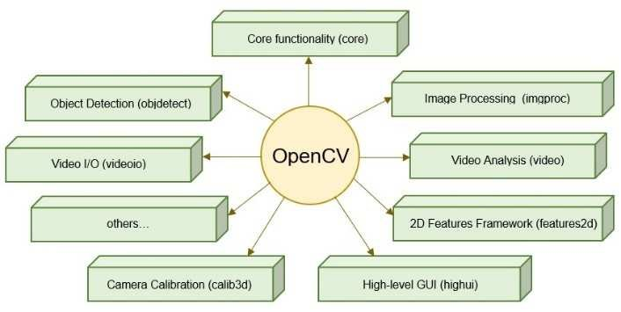
Modules in OpenCV library
Core (core): Basic data structures and mathematical operations
Image Processing (imgproc): Filtering, color conversions, transformations
Video I/O (videoio): Video input/output from files, cameras, streams
Image I/O (imgcodecs): Reads/writes images in formats like JPG, PNG
High-Level GUI (highgui): Basic GUI functions for images and videos
Source :
https://www.researchgate.net/figure/Modular-structure-of-OpenCV_fig2_361594451
Notes:
Core modules in OpenCV
Below are explanations of the core modules in OpenCV and their primary functions: 1. Core Module (core)
Core is the core module in OpenCV, which comprises fundamental data structures and mathematical functions used in the library.
It supports primitive data types, like Mat (matrices), and elementary functions for mathematical operations, array manipulation, and memory management. Basic utilities help in the processing of images and video data across all modules of OpenCV.
2. Image Processing Module (imgproc) The module image processing is based on several functions which can be used for manipulating and analyzing images. The common operations include filtering (like blurring, edge detection), color conversions (like RGB to grayscale), image transformations (like scaling and rotating), and geometric operations. This module is central to tasks like object detection and feature extraction in images.
3. Video I/O Module videoio Videos might be captured or saved; video files might be accessed as live streams, from cameras. With videoio, you can read frames from a file, or capture frames from a camera, and write processed frames to a video file. That is an important module that is applied in video recording and video streaming applications, especially in real-time video analysis.
4. Image I/O Module (imgcodecs) The image I/O module imgcodecs is about reading and writing images into different formats. This module supports the loading of images in all the supported formats like JPEG, PNG, BMP, and TIFF along with saving processed images in supported formats. This module stands in the image processing pipeline in the shape of the reading input images and saving output results according to your desired format, and therefore, is highly useful.
5. High-Level GUI Module (highgui) This module offers basic GUI abilities for displaying images and video. Highgui module enables the window in which one can observe images and videos, grab keyboard or mouse input or design very simple interfaces to display images or video playbacks. Though primarily this is a visualization and debug module, it may sometimes prove very helpful in tests and demonstrations of OpenCV results.

Slide 19
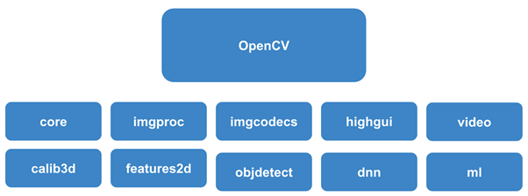
Advanced Modules in OpenCV library
Video Analysis (video): Motion analysis, background subtraction, optical flow
Object Detection (objdetect): Algorithms for face, eye, body detection
Features2D (features2d): Feature detection and tracking (e.g., SIFT, SURF)
Machine Learning (ml): Classification, regression, clustering algorithms
Deep Neural Network (dnn): Loads models trained in TensorFlow, Caffe, etc.
Source :
https://saineshnakra.medium.com/demystifying-cv-the-ultimate-guide-to-choosing-the-right-module-and-library-for-any-computer-86d35ac9fa8a
Notes:
Modules in OpenCV
Here are explanations of some of the advanced OpenCV modules along with their functions in video analysis, object detection, and machine learning:
1. Video Analysis (video)
This module is for video stream motion analysis, moving objects tracking between frames, and change detection in scenes.
Background subtraction is a key feature, useful when moving objects are needed to be separated from a static background. Optical flow helps to track the motion of objects or pixels across frames. This module has a wide range of usage in the applications like surveillance, motion tracking and scene analysis, wherein change with time is critical.
2. Object Detection (objdetect)
The objdetect module provides algorithms that are designed for object detection in images or video frames, including human features and entire bodies.
This module provides pre-trained models for face, eye, and body detection using algorithms such as Haar cascades and the HOG (Histogram of Oriented Gradients) descriptor. It is mainly used for face detection in images and real-time applications such as facial recognition, pedestrian detection, and security systems.
3. Features2D (features2d)
Features2d module is designed to locate the significant points and special textures in images for further analysis or matching.
It includes algorithms such as SIFT (Scale-Invariant Feature Transform) and SURF (Speeded-Up Robust Features), to be able to detect and describe image features. Those are some of the basics applications where stable and recognizable points in an image can be tracked or matched across frames or images, object recognition, image matching, or even augmented reality.
4. Machine Learning (ml)
This module contains some fundamental algorithms of machine learning applied on different tasks such as classification, regression, and clustering suitable for purposes of computer vision.
The ml module consists of common algorithms, such as SVMs, k-NN, and decision trees, which allow the model building for tasks like object tracking, image classification, and predictive analytics. These modules are useful for building intelligent applications that can learn from and adapt to data patterns in images or videos.
5. Deep Neural Network (dnn)
This dnn module allows OpenCV to leverage pre-trained deep learning models, thus equipping it with advanced features to recognize images and detect objects.
This module can be used to load and run models trained in popular deep learning frameworks, including TensorFlow, Caffe, or ONNX. Using the dnn library, application developers can tap into the huge power of deep neural networks for highly accurate, in real-time applications, like facial detection, pose estimation, and much more complex image-based classification. Developers can get the power of deep learning right within the OpenCV framework without training models from scratch.

Slide 20
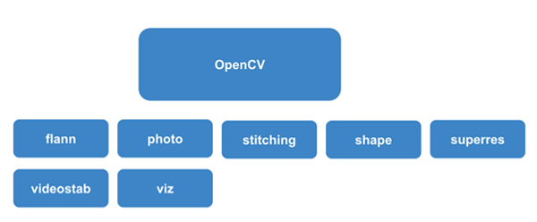
Specialized Modules in OpenCV library
Photo Processing (photo): Image denoising, inpainting, color correction
3D Reconstruction (calib3d): Camera calibration, stereo vision, 3D depth
Shape Analysis (shape): Shape descriptors, contour matching
Optical Flow (optflow): Motion estimation, video stabilization
Tracking (tracking): Object tracking across frames
Stitching (stitching): Image stitching, panorama creation
Source :
https://saineshnakra.medium.com/demystifying-cv-the-ultimate-guide-to-choosing-the-right-module-and-library-for-any-computer-86d35ac9fa8a
Notes:
Specialized Modules in OpenCV
1. Photo Processing (photo)
Modules for image enhancement and restoration often used during photography and media processing.
It has functions for image denoising (removal of noise with details), inpainting (filling in missing or damaged parts of images), and color correction (balancing color to improve image quality). The tools are helpful in image refinement and the removal of imperfections, making the module ideal for applications requiring high-quality visuals.
2. 3D Reconstruction (calib3d)
The calib3d module provides various tools for doing working with data in 3D space - hence providing the capability to see depth and comprehend spatial relations.
camera calibration (correction of lens distortions); stereo vision (calculating depth from two camera views); estimation of 3D depth (measuring distance in the real world). This module is important in such application as augmented reality, 3D scanning, robotics, where depth and perspective come into play.
3. Shape Analysis (shape)
The shape module is designed to recognize and match shapes so that it can identify and classify based on object outlines.
It has a set of shape descriptors which makes quantification of the shapes to be analyzed easier. It also has contour matching which identifies similar shapes based on contours. This module finds its application in applications such as object classification, quality control in manufacturing, and recognition of logo or symbols.
4. Optical Flow (optflow)
The main application of this module is estimation of motion. This track or trace how objects or regions move between frames in a video.
It performs optic flow, video stabilization-calculates the pixel movements on moving frames. This basically determines the flow of data about the pixels between subsequent images which is fundamental to image analytic for robotics and video systems used in motion tracking-helping to track movement through motion analysis or stabilize jittery videos.
5. Tracking(tracking)
The tracking module focuses on maintaining the position of an object across multiple frames in a video.
Tracks objects using multiple algorithms like-KLT, CSRT, MedianFlow etc. that capture objects even as they disappear or change shape.
Highly applicable in the tasks of real-time surveillance applications, sports analytics and more importantly in augmented reality and other similar applications wherein correct, consistent tracking is imperative.
6. Stitching or stitch work
This is the module that allows to combine multiple images into a single, cohesive image, homogenous image, like creating panoramic images.
Functions: It supports functions such as image stitching - lining up two or more images to blend them into one - and the creation of panoramas; generally wide-view images created by merging several photos. This is widely used in photography, virtual tours, and geographic mapping where seamless image merging is important for capturing expansive scenes.
Developers can get the power of deep learning right within the OpenCV framework without training models from scratch.

Slide 21
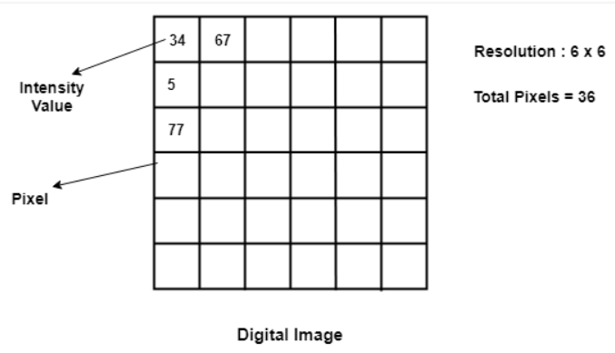
What is a Digital Image?
A digital image is like a picture made of tiny dots called pixels.
These pixels are arranged in rows and columns, similar to tiles on a floor.
Each pixel has a number that shows how bright or dark it is, helping to create the image we see.
Source :
https://theailearner.com/2018/10/06/what-is-a-digital-image/
Notes:
What is an Image?
An image is mathematically represented as a two-dimensional function f(x,y).
In digital images, each pixel is defined by its position within a 2D grid. The variables x and y represent these spatial coordinates or pixel locations, with x usually corresponding to the horizontal position and y to the vertical position. Every pixel’s position allows us to address or modify specific areas within the image.
Variables: x,y: Spatial coordinates (pixel locations).
f(x,y): Intensity or brightness at point (x,y).
f(x, y) represents the intensity (or brightness) value at the coordinate (x, y). In grayscale images, this is often a single value ranging from 0 (black) to 255 (white), where different values indicate varying levels of brightness. In color images, each pixel may have three intensity values (for red, green, and blue channels) instead of just one. Together, these intensity values help create the visible image by encoding light and color information for each pixel.
Image Representation
An image is composed of a grid of discrete values corresponding to x, y, and f(x, y), with each pixel representing the intensity at a specific coordinate. This digital representation enables computers to store, process, and analyze images as arrays of values, making it possible to manipulate individual pixels for a wide range of applications.
Image Processing
Image processing refers to a set of techniques applied to digital images to enhance, modify, or analyze them. The goal is often to make the image more useful or informative by adjusting its characteristics. For example, image enhancement techniques (like adjusting brightness or contrast) improve visual clarity, while image analysis methods (like edge detection) extract features for object recognition. Digital image processing is fundamental in fields like medical imaging, surveillance, and computer vision, where meaningful information must be gathered or highlighted.

Slide 22

What is an Image Processing?
In digital techniques, the manipulation and analysis of images to enhance or gather meaningful information regarding them are usually referred to as image processing.
This is mainly used to enhance, modify, or analyze visual information.
Source :
www.flaticon.com
Notes:
What is an Image?
An image is mathematically represented as a two-dimensional function f(x,y).
In digital images, each pixel is defined by its position within a 2D grid. The variables x and y represent these spatial coordinates or pixel locations, with x usually corresponding to the horizontal position and y to the vertical position. Every pixel’s position allows us to address or modify specific areas within the image.
Variables: x,y: Spatial coordinates (pixel locations).
f(x,y): Intensity or brightness at point (x,y).
f(x, y) represents the intensity (or brightness) value at the coordinate (x, y). In grayscale images, this is often a single value ranging from 0 (black) to 255 (white), where different values indicate varying levels of brightness. In color images, each pixel may have three intensity values (for red, green, and blue channels) instead of just one. Together, these intensity values help create the visible image by encoding light and color information for each pixel.
Image Representation
An image is composed of a grid of discrete values corresponding to x, y, and f(x, y), with each pixel representing the intensity at a specific coordinate. This digital representation enables computers to store, process, and analyze images as arrays of values, making it possible to manipulate individual pixels for a wide range of applications.
Image Processing
Image processing refers to a set of techniques applied to digital images to enhance, modify, or analyze them. The goal is often to make the image more useful or informative by adjusting its characteristics. For example, image enhancement techniques (like adjusting brightness or contrast) improve visual clarity, while image analysis methods (like edge detection) extract features for object recognition. Digital image processing is fundamental in fields like medical imaging, surveillance, and computer vision, where meaningful information must be gathered or highlighted.

Slide 23
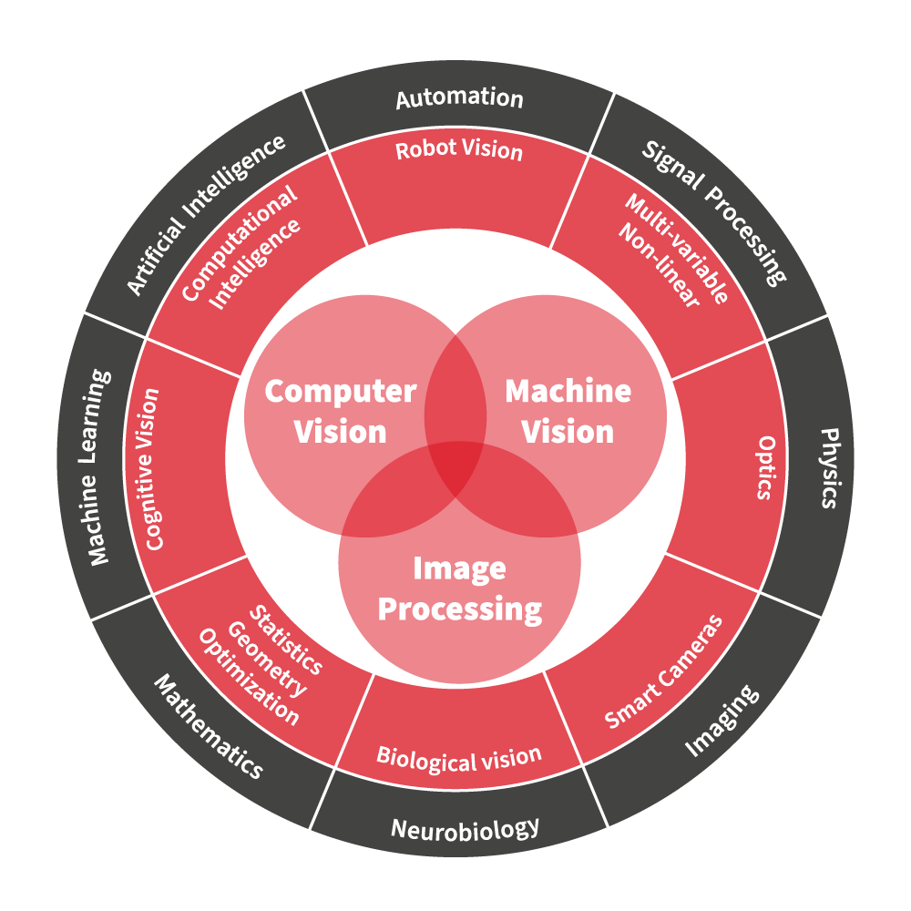
Computer vision Vs Image Processing Vs Machine vision
Aspect | Computer Vision | Image Processing | Machine Vision
Goal | Understand and interpret visual data | Enhance and transform image quality | Automate inspection in industrial settings
Main Use | Recognition, classification, analysis | Improvement, correction, transformation | Quality control, automated analysis
Techniques | Deep learning, machine learning | Filtering, transformations | Image processing + industrial hardware
Examples | Self-driving cars, facial recognition | Noise reduction, edge detection | Defect detection, barcode reading
Source :
https://www.industrialvision.co.uk/news/machine-vision-vs-computer-vision-vs-image-processing
Notes:
Comparison of Computer Vision, Image Processing, and Machine Vision to clarify their distinctions, overlaps, and unique applications:
1. Computer Vision
Computer vision, in basic terms, will enable the computer to 'look' or understand the contents inside their visual frame and take consequent action.
High image understandings, (identification of images, objects, faces or scenes) and can relate to one's perception such that it uses complicated algorithms which contain several machine learnings and also deep learnings in figuring out content.
Applications: Autonomous driving, medical image diagnosis, surveillance, augmented reality, facial recognition.
Typically in uncontrolled or dynamic settings, where conditions like lighting or viewpoint may vary.
Example Tasks:
Object detection and classification (e.g., detecting pedestrians in a video).
Image segmentation (e.g., isolating a specific object within an image).
3D reconstruction (e.g., creating a 3D model from multiple 2D images).
2. Image Processing
Enhance or modification of images applying several algorithms.
Fundamental manipulation of the images for improvement, correction or transformation.
Methods- filtering, transformations and statistical.
Applied across various industries without a specific setting requirement, as it focuses on image quality rather than context.
Applications: Photography, medical imaging, satellite imaging, and media post-processing.
Example Tasks:
Noise reduction (e.g., reducing graininess in a photo).
Contrast enhancement (e.g., making dark images brighter).
Edge detection (e.g., finding boundaries in an image).
3. Machine Vision
Enable automated inspection and analysis in industrial environments.
Application-oriented and specific to industrial needs, often involving controlled conditions for quality inspection.
Methods: Combines image processing with specific hardware (e.g., industrial cameras, lighting).
Applications: Quality control on production lines, defect detection, barcode scanning, and assembly verification.
Controlled environments, typically within factories or manufacturing facilities.
Example Tasks:
Defect detection (e.g., finding flaws in manufactured goods).
Positioning and alignment (e.g., ensuring parts are correctly aligned).
Sorting and counting (e.g., counting items on a conveyor belt).

Slide 24
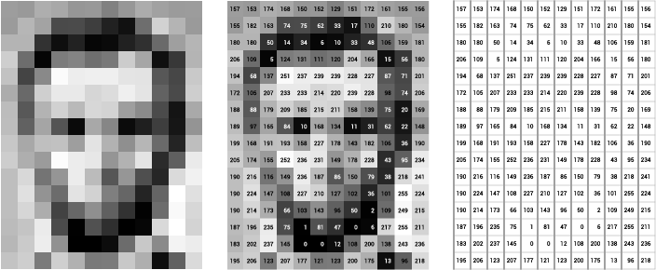
Key Concept of Image Processing
Pixel
A pixel is the smallest unit of a digital image or display.
Each pixel represents a single point of color or intensity in an image.
Source :
https://assets.runemadsen.com/classes/programming-design-systems/pixels/index.html
Notes:
Key Concept of Image Processing
Pixel
A pixel is short for "picture element." It is the smallest unit of a digital image or display. It represents a single point in a raster image and is the basic building block of digital graphics. Every pixel can have information related to color and brightness, making up the overall visual appearance that people see on screens such as monitors, smartphones, and televisions. Their arrangement and characteristics highly influence the quality and clarity of visual content.

Slide 25
Key Concept of Image Processing
Color Models
Frameworks for representing colors in images
Types
RGB (Red-Green-Blue)
CMY(K) (Cyan-Magenta-Yellow-Key/Black)
LAB Lightness-A-B
HSV (Hue-Saturation-Value)
Source :
https://www.vistaprint.com/hub/correct-file-formats-rgb-and-cmyk https://www.luxury-minds.com/what-is-lab-color-space-and-what-should-you-know-about-it-print-peppermint https://www.researchgate.net/figure/Conceptual-depiction-of-the-Hue-Saturation-Value-HSV-space-at-the-heart-of-our-first_fig2_340001129
Notes:
Key Concept of Image Processing
Color Models
Color models describe how colors are used in digital images. Different color channels or components, each model uses to make a spectrum of colors and can be selected according to the application for which the image is intended:
RGB (Red-Green-Blue):
RGB uses three primary color channels: Red, Green, and Blue.
Colors are formed by adding different intensities of these three colors. For example, pure Red is RGB = (255, 0, 0), Green RGB = (0, 255, 0) and Blue RGB = (0, 0, 255). The reason why RGB has gained popularity is that the way it represents colors in simple terms; it's extensively used in digital display, computer graphics, and image editing.
CMY(K) (Cyan-Magenta-Yellow-Key/Black):
Uses Cyan, Magenta, Yellow three colors for printing. With Black (K) adding depth. It's Subtractive mode of printing. It subtracts the light away - Cyan takes out red, Magenta removes green, and Yellow absorbs blue. Principally Color prints. For example, Cyan(100, 0, 0, 0), Magenta(0, 100, 0, 0), Yellow (0, 0, 100, 0), Black (0, 0, 0, 100).
LAB Lightness-A-B:
This LAB model comprises three channels- Lightness L, A and B are green to red, blue to yellow respectively. It is built to give how a human brain perceives the color difference, therefore perceptually uniform. It is mostly used when very good color differentiation is needed such as in color correction, and advanced image editing, etc.
HSV (Hue-Saturation-Value):
Hue (color type), Saturation (color intensity), and Value (brightness). Often visualized as a cone or cylinder where hue is the angle, saturation is the radius, and value is the height. Useful in color filtering, image segmentation, and human-centered design, as it aligns closely with human color perception. A red hue might be represented as (0°, 100%, 100%), where hue is in degrees.

Slide 26
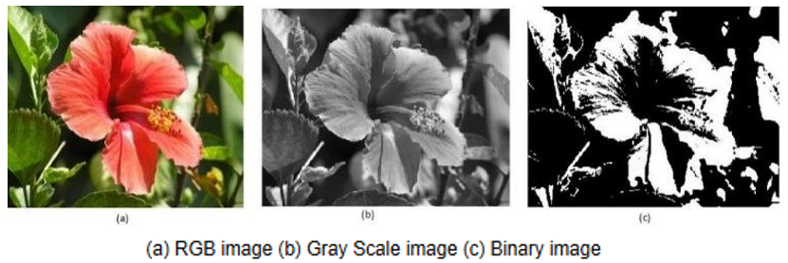
Key Concept of Image Processing
Image Types
Images are classified according to the number of values a pixel can take
Color Images
Grayscale Images
Binary Images
Source :
https://www.researchgate.net/figure/Figure2-a-RGB-image-b-Gray-Scale-image-c-Binary-image_fig2_344249310
Notes:
Key Concept of Image Processing
Image Types
Images are classified according to the number of values a pixel can take, and each type is used for a different purpose:
Binary Images:
Consist of only two colors, usually black and white. Helpful for simple graphics and document scanning where the presence or absence of an element is required, such as in text and line detection.
Grayscale Images:
Grayscale images contain different shades of gray. The intensity values vary from black that is 0 to white that is 255. It is widely used in various applications such as edge detection, texture analysis, and in medical imaging, where intensity changes are more pronounced than colors.
Color Images:
Composed of a multi-channel format, like RGB, to represent the wide range of colors. Most widespread in photography, video processing, and general digital media applications that require full-color representation.

Slide 27
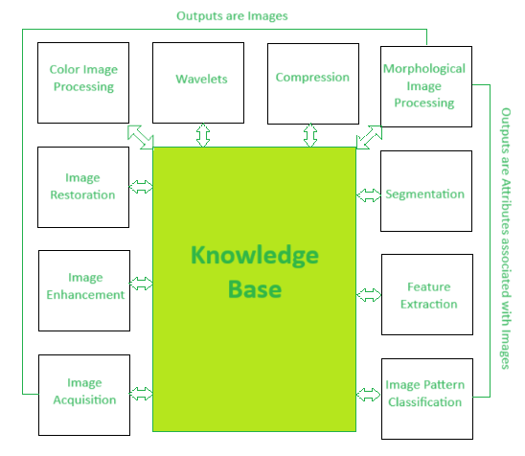
Core Components in Image Processing
Image Acquisition
Image Enhancement
Image Restoration
Color Image Processing
Wavelets
Compression
Morphological Image Processing
Segmentation
Feature Extraction
Image Pattern Classification
Source :
https://www.geeksforgeeks.org/fundamental-steps-in-digital-image-processing/?ref=ml_lbp
Notes:
Key phases of Image Processing
The diagram illustrates key phases in image processing, image classification and computer vision. Let us go through each phases with examples:
Image Acquisition: This is the process of capturing an image, like taking a photo with a camera. For instance, when you snap a picture with your phone, you’re acquiring an image to work with.
Image Enhancement: This phase improves the visual appearance of an image, making it clearer. An example is adjusting brightness and contrast on a photo to make details more visible.
Image Restoration: This involves fixing image imperfections, like reducing blurriness or removing noise. For example, if an old photograph is damaged, restoration can help make it look as clear as possible.
Color Image Processing: This is about adjusting or analyzing color information. An example is changing the color tone of an image, like applying a black-and-white filter or enhancing certain colors for better visibility.
Wavelets: Wavelets help in breaking down images into smaller parts for analysis or compression. For instance, wavelet processing is used in image compression to reduce file size while preserving important details.
Compression: This reduces the image size without much loss of quality, useful for saving storage. For example, JPEG is a common format that compresses images to make them smaller.
Morphological Image Processing: This is about analyzing shapes and structures in images. An example is using filters to identify specific shapes, like detecting circles in an image of a basketball court.
Segmentation: This phase divides an image into meaningful sections. For instance, in a photo of a classroom, segmentation might separate each student’s face for individual analysis.
Feature Extraction: This identifies specific characteristics in the image, like edges or textures. An example is detecting facial features in a selfie for face recognition.
Image Pattern Classification: This phase classifies objects or patterns within an image. For example, in a traffic monitoring system, this might classify vehicles into types (e.g., cars, trucks, buses).

Slide 28
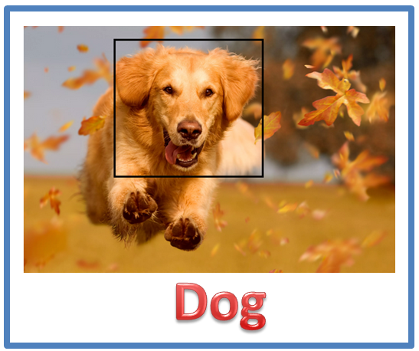
What is Image Classification ?
Image classification is a task in computer vision where a model is trained to categorize images into specific labels based on their visual content.
Example- Given images of various animals, the model can learn to classify each as a dog, cat, or bird.
Importance of Image Classification
Enables computers to understand and categorize visual data, which can enhance decision-making, automate tagging, and improve safety.
Real-World Impact: Helps in sustainable solutions, such as monitoring wildlife, improving healthcare diagnostics, and optimizing resources in agriculture.
Source :
Notes:
Image Classification in Computer Vision
The classification of images to labels or classes is one of the basic tasks in computer vision that trains a model to recognize pictures based on contents. Feed the model labeled images so that it may learn patterns, textures, and features unique to a category so that it can be able to make correct classifications for new, unseen images. Suppose we train a model with labeled images of animals like dogs, cats, and birds. After that, the model can recognize an image of an unknown animal and can determine if it is a dog, cat, or bird using learned characteristics. Importance of Image Classification Image classification basically enables computers to interpret visual information in ways useful for human tasks, like simple organization, analysis, and decision making based on the data from images. Example: Automatic tagging of social media picture consisting of how a model can identify and tag people or things in the pictures. Many areas in classification can have automation capability. For example, manufacturing automatically employs quality control systems in its use that makes the utilization of image classification on defects, therefore creating productive and safe products. In the medical area, classification can point to some of the potential problems within medical scans. This then helps a doctor identify some issues quickly and in an efficient manner.
Real World Impact and Sustainable Solutions Wildlife Monitoring: Species can be monitored, the populations of animals tracked, and endangered species spotted in their habitats through image classification. It supports conservation activities with important information gathered with minimal human influence. Healthcare Diagnostics: The use of image classification will help diagnose a disease much earlier, given that there is the interpretation of X-rays, MRIs, among other medical images, thus good patient care and resource allocation. Agriculture: This application classifies images used in crop monitoring, identifying pests and assessing soil conditions in order to optimize resource usage and enhance sustainable farming.

Slide 29
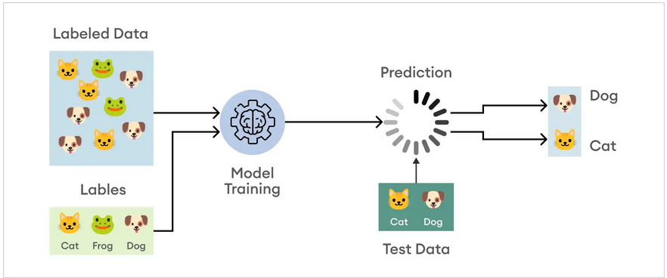
How Does Image Classification Work?
Process Overview:
Step 1: Data Collection: Gather a labeled dataset with images assigned to categories (e.g., animals, vehicles).
Step 2: Training the Model: The model learns patterns within labeled images using supervised machine learning.
Step 3: Feature Extraction: Identifies features like colors, textures, shapes, and edges.
Step 4: Classification: Assigns labels to new, unseen images based on learned features.
Source :
https://www.superannotate.com/blog/image-classification-basics
Notes:
How Does Image Classification Work?
Image classification process entails several steps that enable a model to learn from visual data and predict new images. Here is the overview of each step in the process outlined below:
Process Overview
Step 1: Data Collection
This is the first step, which involves a labeled dataset of images. Images are assigned to classes or categories, for example animals, such as dogs and cats, and vehicles, such as cars and bicycles.
Quality and size: The quality and size of the dataset are important because a large and representative dataset will help the model learn. Ideally, images will have been taken under different conditions, angles, and backgrounds in order to improve the robustness of the model.
Step 2: Training
In the second step, a learning machine model trains on the labeled data set. A CNN generally learns to recognize visual patterns or features that are associated with each label as it trains from the data in the training phase.
This process is termed supervised learning because the model is trained on input-output pairs: images and their corresponding labels. Training will involve adjusting the model's internal parameters in a manner that minimizes the difference between its predictions and actual labels.
Step 3: Feature Extraction/Test Data
After the model has been trained, its function is to extract salient features from images and to include colors, texture, shapes, and edges. This is a significant step because the features detected will be used in order to classify between different classes.
In deep learning, features are learned and extracted by the convolutional layers of a CNN. In the traditional approach, one could use SIFT or HOG, among other things, to manually extract features.
Step 4: Classification
The final step of this model is that it would classify new images it had not seen by labeling it based on features it would have learned while training. Whenever a new image was inputted, the model took the image and passed it through the architecture learned. The output of this was an idea of what category of image it represented.
The output for each category often comes back as a probabilistic score, giving how confident it is that such a thing has happened, and you take the output of the best category score, which is the outcome.

Slide 30
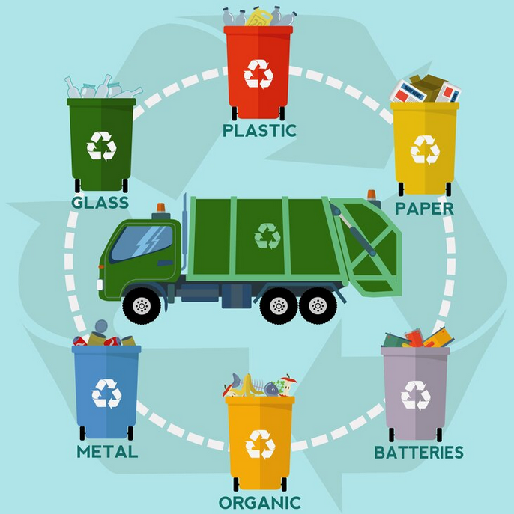
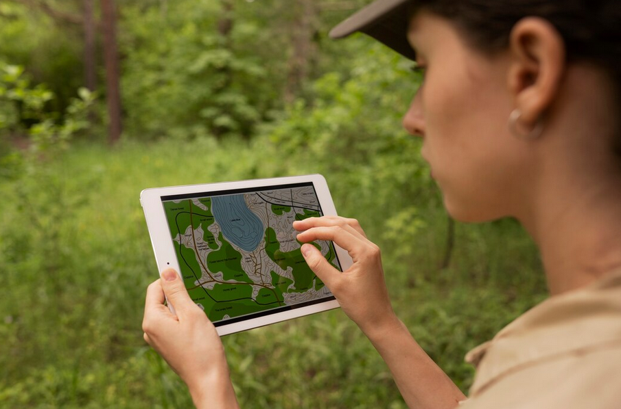
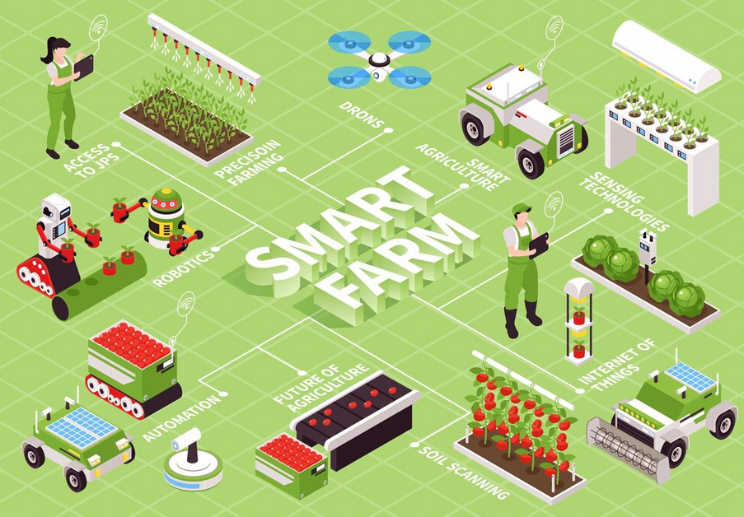
Examples of Image Classification in Green Technology
Waste Sorting for Recycling : Recycle materials like plastic, paper, and metal, which helps reduce waste
Ecosystem Monitoring: Computers can look at these pictures and classify what they see, like identifying different plants, animals, or even pollution in the water.
Smart Farming for Healthier Crops: The computer can classify the plants into categories like "healthy" or "needs help."
Source :
www.freepik.com
Notes:
Examples of Image Classification in Green Technology
1. Waste Sorting for Recycling
Proper waste segregation is essential for effective recycling, but manual sorting can be slow and prone to errors.
Solution:
Automated Sorting Systems: Using image classification algorithms, cameras are installed on conveyor belts in recycling facilities. These systems take images of waste items as they pass by.
Classification Process: The computer analyzes the images and classifies the items into categories such as plastic, paper, metal, or non-recyclable materials.
Outcome:
Efficiency: Automated systems can process items faster than humans, significantly speeding up the sorting process.
Increased Recycling Rates: By ensuring materials are sorted correctly, more items are successfully recycled, reducing the amount of waste sent to landfills and lowering environmental impact.
2. Ecosystem Monitoring
Monitoring biodiversity and environmental health in remote areas is challenging and labor-intensive.
Solution:
Drone Technology: Drones equipped with high-resolution cameras can capture aerial images of ecosystems such as forests, wetlands, and oceans.
Image Classification: Machine learning algorithms analyze these images to classify various elements, such as:
Flora and Fauna: Identifying different species of plants and animals present in the area.
Environmental Hazards: Detecting signs of pollution, illegal logging, or habitat destruction.
Outcome:
Data Collection: Scientists can gather extensive data over large areas without disturbing the environment.
Conservation Efforts: By identifying stressed or endangered species and monitoring habitat conditions, targeted conservation actions can be implemented more effectively.
3. Smart Farming for Healthier Crops
Farmers often struggle to monitor crop health across large fields, leading to inefficient resource use and reduced yields.
Solution:
Crop Monitoring Systems: Using cameras and image classification techniques, farmers can capture images of their crops from the ground or via drones.
Classification of Plant Health: The system analyzes the images to categorize plants into classes such as "healthy," "diseased," or "needs irrigation." This can include identifying:
Nutrient Deficiencies: Recognizing signs of yellowing leaves or stunted growth.
Pest Infestation: Detecting the presence of pests or diseases early.
Outcome:
Precision Agriculture: Farmers receive detailed insights into crop health, allowing for targeted interventions, such as applying fertilizers or pesticides only where needed.
Sustainability: This approach minimizes chemical use, conserves water, and enhances overall crop productivity, contributing to more sustainable farming practices.

Slide 31
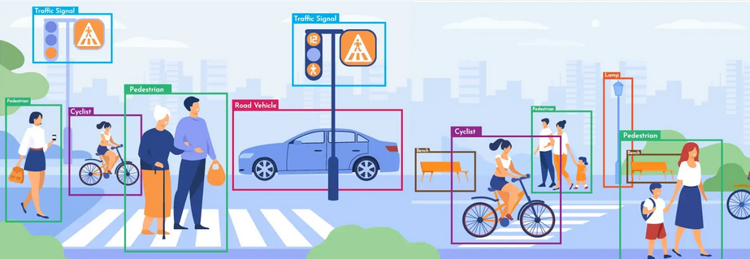
What is Object Detection?
Object detection allows computers to recognize and locate objects within an image.
Key Components of Object Detection
Recognition: It detects objects, such as animal, cars, trees, people, and others
Localization: It identifies location of where the object is situated in the image.
How Object Detection Works
Step 1: The computer scans the image.
Step 2: It identifies the objects within the image.
Step 3: It locates the position of each object.
Step 4: Outputs the object's label and location.
Source :
https://futuristech.com.au/services/computer-vision/object-detection/
Notes:
What is Object Detection?
Object detection enables computers to not only recognize but also locate objects within an image.
Think of it like playing hide-and-seek: you spot your friends hiding, and you also know exactly where they are in the image. Similarly, object detection finds the objects and pinpoints their location.
Key Components of Object Detection
Recognition: This is when the system identifies the object. For example, it might recognize animals, cars, trees, people, or other objects in an image.
Localization: Once the object is recognized, the system identifies where the object is located within the image.
Example: I found a tree right here in the picture, meaning the system not only recognizes that it’s a tree but also locates it in a specific region of the image.
How Object Detection Works
Step 1: The computer first scans the image to analyze its contents.
Step 2: It then identifies the objects within the image. This step is about recognizing what is present.
Step 3: Next, it locates the position of each object in the image, usually drawing bounding boxes around the objects.
Step 4: Finally, the system outputs the object's label (like "tree" or "car") along with its location in the image (often with coordinates or bounding boxes).

Slide 32
Applications of Object Detection in Real Life
Object detection has a wide range of applications in real life
Wildlife Monitoring: Drones capture images of forests to detect animals.
Self-Driving Cars: Self-driving cars identify other cars, pedestrians, and road signs.
Medical Imaging: Detects anomalies like tumors, fractures, or infections in medical images
Security and Surveillance: Detects intruders, weapons, or unusual movements in video surveillance feeds.
Retail and Inventory Management: Tracks products on shelves in real-time and manages stock levels.
Augmented Reality (AR): AR apps detect physical objects and allow users to visualize them in real-world settings.
Manufacturing and Quality Control: Inspects products for defects, misalignments, or missing parts on production lines.
Traffic Management and Law Enforcement: Detects vehicles, red-light violations, and tracks license plates for speed enforcement.
Disaster Response and Rescue Missions: Drones locate survivors or people in danger after natural disasters.
Source :
Notes:
Applications of Object Detection in Real Life
Object detection has a wide range of applications in real life, enhancing various industries from wildlife conservation to traffic management.
Wildlife Monitoring
Drones capture images of forests to detect tigers.
Benefit: Helps scientists track animals without disturbing them, protecting wildlife.
Self-Driving Cars
Object detection helps self-driving cars identify other cars, pedestrians, and road signs.
Benefit: Ensures safety by constantly monitoring the surrounding environment.
Medical Imaging
Detects anomalies like tumors, fractures, or infections in medical images (X-rays, MRIs, CT scans).
Benefit: Helps doctors diagnose diseases earlier and more accurately, improving treatment outcomes.
Security and Surveillance
Detects intruders, weapons, or unusual movements in video surveillance feeds.
Benefit: Provides real-time alerts, enhancing public and private safety.
Retail and Inventory Management
Tracks products on shelves in real-time and manages stock levels.
Benefit: Helps prevent stockouts and speeds up the checkout process (self-checkout).
Augmented Reality (AR)
AR apps detect physical objects (e.g., furniture, clothing) and allow users to visualize them in real-world settings.
Benefit: Enhances the user experience by integrating digital information with physical objects.
Manufacturing and Quality Control
Inspects products for defects, misalignments, or missing parts on production lines.
Benefit: Increases production speed, consistency, and reduces waste.
Traffic Management and Law Enforcement
Detects vehicles, red-light violations, and tracks license plates for speed enforcement.
Benefit: Improves traffic flow and road safety.
Disaster Response and Rescue Missions
Drones locate survivors or people in danger after natural disasters (earthquakes, floods).
Benefit: Speeds up rescue operations and saves lives.
Environmental Monitoring and Conservation
Tracks environmental changes like tree cover, species identification, and pollution levels.
Benefit: Supports data-driven decisions for environmental protection and conservation.

Slide 33
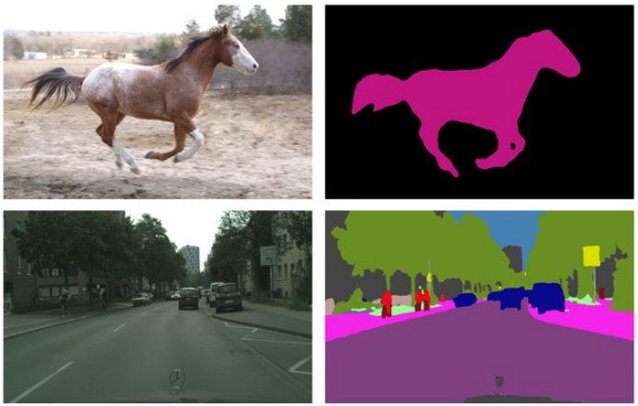
What is Image Segmentation?
In image segmentation, it divides an image into smaller, meaningful parts called segments.
Why is Image Segmentation Important?
Each segment represents a different object or area, making it easier for the computer to understand the image.
Helps computers focus on individual parts of an image to understand what is happening in the picture.
Increases accuracy and precision in tasks like object recognition, medical imaging, and autonomous driving.
Source :
https://www.researchgate.net/publication/337771814_Waterfall_Atrous_Spatial_Pooling_Architecture_for_Efficient_Semantic_Segmentation
Notes:
What is Image Segmentation?
Image segmentation is similar to a puzzle. The computer breaks down an image into smaller, meaningful parts called segments. Each segment represents a different object or area and enables the computer to analyze the image in more manageable pieces.
Why is Image Segmentation Important?
Segmentation makes the computer understand each piece of the image better. Therefore, it can zoom in on different parts of the image. This way, the computer can more easily identify and understand the different objects or areas of the image.
Segmentation allows the computer to enhance the correctness and accuracy of tasks such as object recognition, where each object can be separated and defined more clearly.
It is very helpful in critical fields, like medical imaging, where separate parts of an image are found and analyzed to aid the diagnosis of diseases or even in autonomous driving, where segmenting objects such as pedestrians or road signs can navigate the car and maintain its safety.

Slide 34
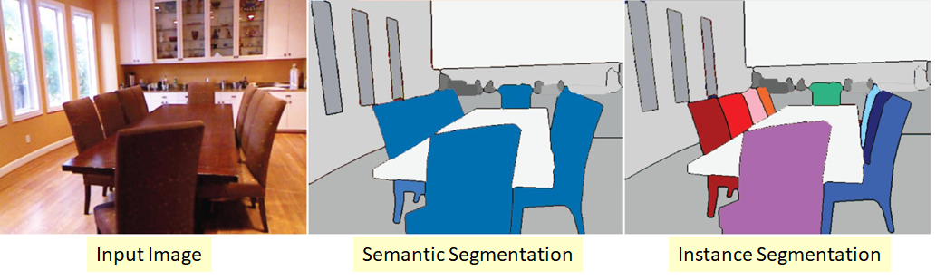
Types of Image Segmentation
Semantic Segmentation:
Assigns each pixel to a class.
No differentiation between instances of the same class.
Instance Segmentation:
Identifies and labels each individual object in an image.
Differentiates between instances of the same class
Source :
https://blog.roboflow.com/difference-semantic-segmentation-instance-segmentation/
Notes:
Types of Image Segmentation
Semantic Segmentation:
In semantic segmentation, every pixel of an image is assigned to a particular label like "car," "road," and "tree." However, no difference is made among the different objects of the same class. For example, if there are several cars in the image and the model does not differ between them, then it will label all the cars as "car.".
Example: The technique tags as "car" one whole picture with several cars present without marking any as having different specific names for separate individual cars.
Instance Segmentation:
The difference is a better class because it allows tagging and detection of specific elements regardless of whether the things detected within the images bear resemblance in terms of kind.
For example, by tagging cars as if different based on the existence within a similar class as distinct and by using distinctive identifications or names while indicating a presence of other things with which they resemble while they might not resemble to another.
Example: In an image where there are many cars, each car will be individually labeled, say "car 1," "car 2," and so on.

Slide 35
Segmentation Techniques
Deep Learning Models: Convolutional Neural Networks (CNNs) are often used for segmentation tasks.
Popular Architectures:
U-Net: Specialized for medical imaging and precise segmentation.
Mask R-CNN: Performs instance segmentation, distinguishing objects within the same class.
Fully Convolutional Networks (FCNs): Used for pixel-wise segmentation tasks.
Source :
Notes:
Segmentation Techniques
Deep Learning Models: The popular models used in the problem of image segmentation are CNNs as they are space feature-capturing as well as can carry pixel-wise analysis.
Popular Architectures:
U-Net
U-Net is highly specialized for medical imaging and accurate segmentation. It's very good at segmenting structures in images where accuracy matters, such as detecting tumors in medical scans.
Mask R-CNN
Mask R-CNN is a deep learning model used for instance segmentation. It can detect objects and create pixel-wise masks for each instance, which means it can distinguish between different objects of the same class.
Fully Convolutional Networks (FCNs)
FCNs apply to pixel-wise segmentation tasks, where the network generates a segmentation map with which class labels are assigned to every pixel, and thus it is widely applied in various segmentation applications.

Slide 36
Importance of Image Segmentation in Green Technology and Sustainability
Resource-Efficient Agriculture
Analyzes crop and prevents waste and reduces environmental damage
Environmental Monitoring and Conservation
Serves in the conservation and monitoring of sustainable ecosystem health
Energy Efficiency in Smart Cities
Used to examine land use, energy use, and traffic flow within smart cities
Waste Management and Recycling
Climate Research and Disaster Response
Automatic sorting of recyclables, such as plastics, metals, and organics
Identify changes in climate and the development of storms
Source :
Notes:
Importance of Image Segmentation in Green Technology and Sustainability 1. Resource-Efficient Agriculture:
Analyzes crop health, soil quality, and pest infestations Enables precision farming: water, fertilizers, and pesticides are applied only where they are needed. It prevents waste and reduces environmental damage.
2: Environmental Monitoring and Conservation
The process of segmentation in satellite and drone imaging monitors the progression of deforestation, pollution, and habitat degradation Identifies and isolates changes in the ecological condition with high accuracy. Serves in the conservation and monitoring of sustainable ecosystem health
3: Energy Efficiency in Smart Cities
Used to examine land use, energy use, and traffic flow within smart cities. Utilized for the optimization of the supply of energy, minimizing emissions, and resource distribution. Consistent with green technologies and the pursuit of sustainable city development.
4: Waste Management and Recycling
Automatic sorting of recyclables, such as plastics, metals, and organics. Increases the accuracy in the sorting process at a recycling facility. Increases the rate of recycling, lowers the amount of waste landfilled, and supports the circular economy.
5: Climate Research and Disaster Response
Extremely critical to analyze satellite images to identify changes in climate and the development of storms. Critical to post-disaster analysis and response assessment Critical for effective and resource-saving disaster responses.

Slide 37
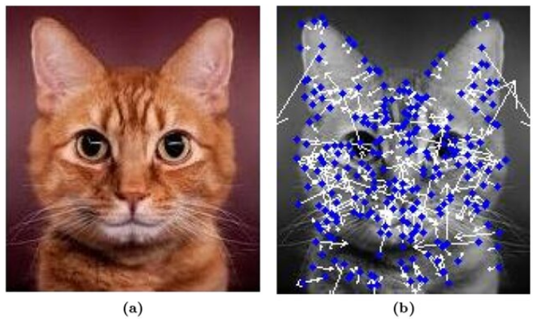
What is Feature Extraction?
Identifying key visual elements within an image.
Examples of features:
Edges: Boundaries within objects.
Textures: Patterns or smoothness of surfaces.
Shapes: Geometric structures.
Colors and Spatial Patterns: Color distributions and arrangements.
Source :
https://www.researchgate.net/publication/264273290_Bilateral_Symmetry_Detection_on_the_Basis_of_Scale_Invariant_Feature_Transform/figures?lo=1
Notes:
Feature Extraction in Computer Vision
It is the process of discovering and isolating important elements of an image. This means that these elements help the computer to interpret images more effectively. Examples of Key Features
Edges
Edges are the boundaries between objects, where there's a sharp contrast in brightness or color.
These edges help the system detect outlines and shapes in a picture, such as car or building edges.
Textures:
Textures are patterns or smoothness on surfaces. For instance, how rugged tree bark is, or how glassy a windowpane is.
Textures are used to identify what material is or surface quality. This comes in handy in trying to differentiate between one object from another.
Shapes:
Shapes are the geometric entities in the image, circular, rectangular, or an irregular shape.
Shape properties are used to identify the objects in the image according to their outline or silhouette, like identifying a wheel or a door.
Colors and Spatial Patterns:
Color features distinguish objects or areas based on objects that are nearly shape isometric but color different.
Techniques for Feature Extraction
Edge Detection: Detects boundaries and outlines within images.
Corner Detection: Identifies points where edges meet, useful for identifying shapes.
Feature Descriptors: SIFT (Scale-Invariant Feature Transform): Detects distinctive points invariant to scale and rotation.
SURF (Speeded Up Robust Features): Similar to SIFT but faster.
HOG (Histogram of Oriented Gradients): Captures local edge directions for object detection.

Slide 38
Importance of Feature Extraction in Green Technology and Sustainability
Precision Agriculture and Resource Management
Extracts the features of soil texture, leaf color, crop patterns.
Renewable Energy Optimization
Provide weather conditions, terrain characteristics, and environmental indices.
Wildlife and Biodiversity Monitoring
Identify plant and animal species, forest types, and the health of vegetation.
Smart Waste Management
Disaster Risk Assessment and Climate Monitoring
Automated sorting of different types of material
Analyzes features in coastal areas, flood plains, etc., for risk forecasting
Source :
Notes:
Importance of Feature Extraction in Green Technology and Sustainability
Precision Agriculture and Resource Management
Extracts the features of soil texture, leaf color, crop patterns.
Sustainable Utilization: Determines the phases of crop growth and nutrient deficiency
Enables fertilizers, water, and pesticides application in the affected areas
It minimizes chemical overflow and ensures positive utilization of resources
Renewable Energy Optimization
Explain weather conditions, terrain characteristics, and environmental indices.
Solar and Wind Energy Systems identifies characteristics like cloud cover and solar irradiance for energy output forecasting.
It provides stable and efficient renewable energy generation.
Wildlife and Biodiversity Monitoring
Ecological Health: It can identify plant and animal species, forest types, and the health of vegetation.
Conservation Support: Precise biodiversity and habitat health monitoring
Ecosystem Protection: Enables sustainable ecosystem management for maintaining biodiversity
Smart Waste Management
Automated Sorting: Features extraction for classification of material types like metals, plastics, and organics.
Circular Economy: Increases segregation for recycling activities.
Decreases landfill waste and promotes waste recycling.
Environmental Impact: Increases recycling efficiency and reduces waste.
Disaster Risk Assessment and Climate Monitoring
Risk Forecasting: Analyzes features in coastal areas, flood plains, etc., for risk forecasting.
Climate Impact Analysis: Determines shoreline erosion, water level rise, and forest changes.
Sustainable Protection: Provides disaster management plans with less resource utilization.

Slide 39

Lab Activity
Hands On
Lab 1
Forest Fire Detection Using Satellite Imagery

Slide 40
Lab Activity
Hands On
Lab 2
Waste Sorting Using Computer Vision

Slide 41

Conclusion
Computer vision stands out as the most ultimate and transformative machine tool in interpreting the human visual world.
The applications are in green technology and sustainability to change for better-from monitoring the ecosystem to optimizing resources.
Few of the widely used very general tools include OpenCV, modules and basic tasks
Image classification, object detection, segmentation, and feature extraction techniques with some examples.
Such capabilities can be used towards developing innovations that support two important ideas: technology innovation and sustainability.
Source :
www.freepik.com/

Slide 42
References
https://www.hyperscience.com/knowledge-base/computer-vision/
https://www.csm.tech/in/offering/computer-vision
https://aws.amazon.com/what-is/computer-vision/
https://www.ibm.com/topics/computer-vision
https://viso.ai/applications/computer-vision-in-environmental-conservation-applications/
https://montrealethics.ai/computer-vision-and-sustainability/
https://viso.ai/computer-vision/the-most-popular-computer-vision-tools/
https://medium.com/javarevisited/important-libraries-of-opencv-56b14705bf0e
https://en.wikipedia.org/wiki/OpenCV
https://opencv.org/about/
https://www.geeksforgeeks.org/opencv-overview/

Slide 43


Let’s Start

Slide 44


Quiz
Computer vision primarily involves which of the following tasks?
(a) Developing 3D computer graphics
(b) Creating efficient database storage systems
(c) Analyzing and interpreting visual data from images or videos
(d) Performing text-based language translation
Answer: C
Analyzing and interpreting visual data from images or videos
Notes:
Computer vision primarily involves which of the following tasks?
A. Developing 3D computer graphics
B. Creating efficient database storage systems
C. Analyzing and interpreting visual data from images or videos
D. Performing text-based language translation
Answer: C

Slide 45
Quiz
2. Which of the following is an example of how computer vision can aid in green technology?
Automatic crop monitoring to improve agricultural efficiency
Voice recognition for AI assistants
Data compression algorithms for faster processing
Creating video games with realistic graphics
Answer: A
Automatic crop monitoring to improve agricultural efficiency
Notes:
Which of the following is an example of how computer vision can aid in green technology?
A. Automatic crop monitoring to improve agricultural efficiency
B. Voice recognition for AI assistants
C. Data compression algorithms for faster processing
D. Creating video games with realistic graphics
Answer: A
Automatic crop monitoring to improve agricultural efficiency

Slide 46
Quiz
3. Which of the following statements about OpenCV is true?
OpenCV is primarily a data processing library for financial transactions.
OpenCV is an open-source library focused on image processing and computer vision tasks.
OpenCV was developed to primarily support machine learning-based data analysis.
OpenCV is a closed-source, commercial software for video analysis only.
Answer: B
OpenCV is an open-source library focused on image processing and computer vision tasks.
Notes:
Which of the following statements about OpenCV is true?
A. OpenCV is primarily a data processing library for financial transactions.
B. OpenCV is an open-source library focused on image processing and computer vision tasks.
C. OpenCV was developed to primarily support machine learning-based data analysis.
D. OpenCV is a closed-source, commercial software for video analysis only.
Answer: B

Slide 47
Quiz
4. Which of the following functions is used in OpenCV to read an image?
cv2.imshow()
cv2.imread()
cv2.detect()
cv2.segment()
Answer: B
cv2.imread()
Notes:
Which of the following functions is used in OpenCV to read an image?
A. cv2.imshow()
B. cv2.imread()
C. cv2.detect()
D. cv2.segment()
Answer: B

Slide 48
Quiz
5. What is the primary goal of image segmentation?
To classify the entire image into a single label
To divide the image into meaningful regions or segments
To enhance the color quality of an image
To reduce the resolution of an image
Answer: B
To divide the image into meaningful regions or segments
Notes:
What is the primary goal of image segmentation?
A. To classify the entire image into a single label
B. To divide the image into meaningful regions or segments
C. To enhance the color quality of an image
D. To reduce the resolution of an image
Answer: B

Slide 49
Thank You
Notes:
Thank You !!

